Slide 1
Internship Review

Slide 2
Presented By Alok Ranjan
Project: Orange Belgium
Internship Duration: 25th April 2025 – 21st June 2025
Project Supervisor: Archana Bhat
Project Buddy: Nancy Mary J
Department: Data & AI
Location and Facility: Bengaluru-BDC7A
Under the Guidance of :
1. Sunil Kaduba Pawar
2. Saikat Kumar Pani

Slide 3

Building a Reusable Telecom Data Pipeline on Google Cloud Platform

Slide 4
AGENDA
Project Summary
Business Problem Statement
Technical Approach
Implemented Solutions & Recommendations
Challenges Faced
Resources
Learnings and Internship Impact

Slide 5

PROJECT SUMMARY
Overview of the Telecom Data Pipeline Project
Project Title: Develop a reusable Telecom Data Pipeline using Google Cloud Platform
Project Description: The project involved designing a reusable data pipeline template for a telecom company using GCP services.The system efficiently ingests streaming JSON data, transforms it, stores it in Cloud Spanner, and captures changes to stream them into BigQuery for analytical insights.
Project Objective: Design and implement a reusable data ingestion pipeline which ensures reliable storage, change tracking and efficient data analysis for telecom operations.

Slide 6

PROBLEM STATEMENT
Telecom Companies often deal with high volumes of dynamic data continuously generated.
Legacy infrastructure causes delays, poor customer insight leading to inefficiencies in decision making.
Batch processing fails to meet the demand for real-time analytics.
No effective mechanism to track changes and update data warehouses immediately.
The business requires a solution that enables reusability essential for agile, customer – centric decision making.

Slide 7

TECHNICAL APPROACH

Slide 8
Data Engineering Approach Overview
1
2
3
4
Data Ingestion
database Design
Architecture design
Implementation phase
Raw telecom data is ingested from JSON files, as structured messages via Pub/Sub from various service sources and applications.
Normalized Cloud Spanner schema designed to efficiently model telecom entities like Customers, Accounts, Usage, Billing, and Tickets.
Engineer a resilient architecture using Apache Beam, Spanner, and BigQuery to ensure real-time, scalable data processing and analytics.
Implemented streaming pipeline: ingested JSON via Pub/Sub, transformed in Dataflow, stored in Spanner, and pushed changes to BigQuery.

Slide 9
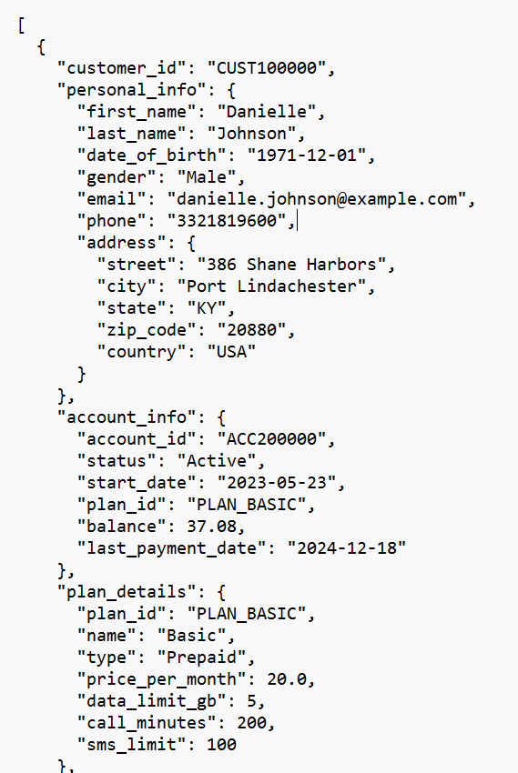
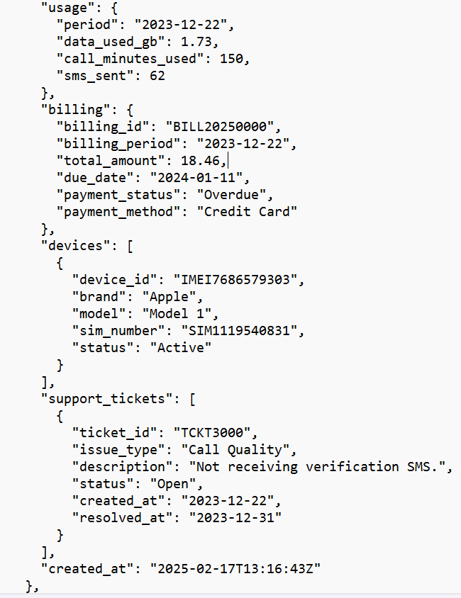
Data Ingestion – Telecom Dataset Overview
The pipeline begins with ingestion of structured telecom metadata in JSON format. The sample dataset includes key fields such as customer_id, billing_id, account_id, timestamp, and other fields representing transactional snapshots captured from telecom systems in near real-time.
customer_id
UNIQUE IDENTIFIER
Source: JSON files from telecom data generators
Format: Nested and flat JSON structures
Key Fields: customer_id, billing_id, account_id, region, plan_type, created_at timestamp
Ingestion Trigger: Automated via Pub/Sub topic
created_at
TIMESTAMP

Slide 10








Data Modeling and Normalization
Converted raw JSON
Relational Schema
Applied 3NF
Split into Entities
Established Key Relationships
Developed a logical structure for storing data in relational tables efficiently.
Normalized the database to the third normal form or higher for data integrity.
Divided the schema into essential entities like Customers, Accounts, and more.
Transformed raw data into a structured relational schema for better organization.
Defined foreign key and primary key relationships to maintain data consistency.

Slide 11
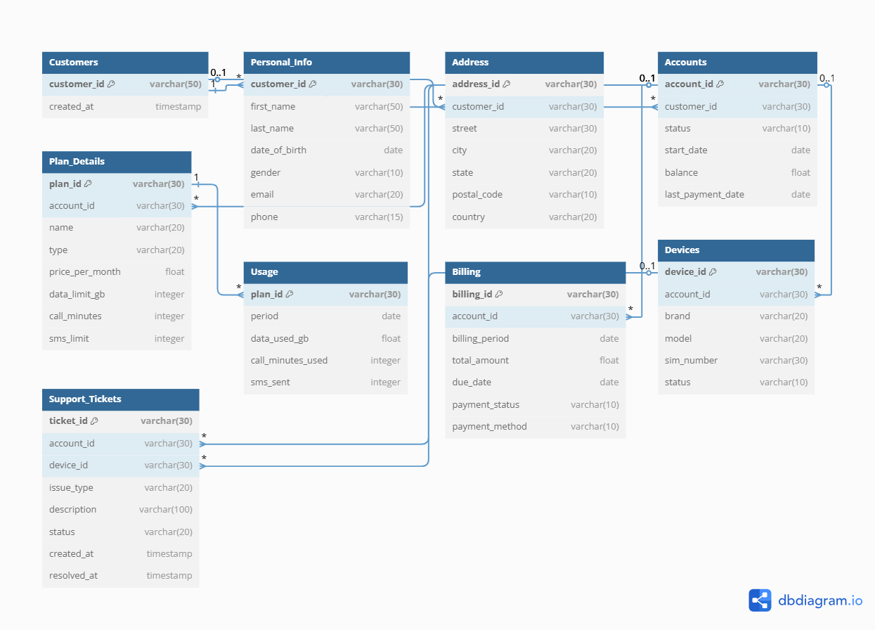

Slide 12

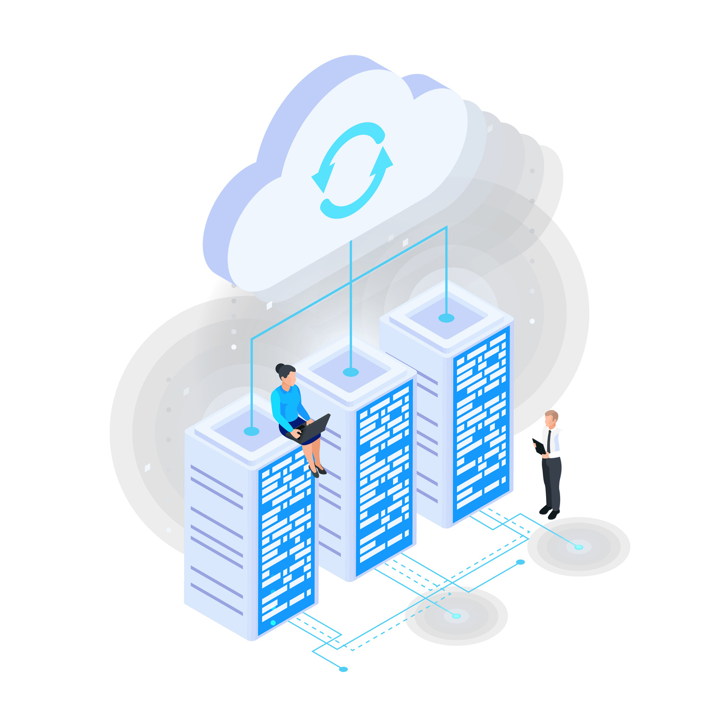


Cloud Architecture Design Overview
The architecture uses Pub/Sub, Dataflow, Spanner, and BigQuery to build a scalable, real-time, cost-effective pipeline with fault tolerance and change data capture support.

Slide 13
Key Components of the Cloud Architecture
Dataflow
Pub/Sub
Cloud Spanner
BigQuery
Processes streamed messages, transforms data, and forwards structured records into Cloud Spanner seamlessly.
Receives and streams telecom JSON data, decoupling ingestion from processing in real time.
Stores normalized telecom data with interleaved tables, ensuring scalability and relational consistency.
Receives processed change records from Spanner enabling real-time analytics and insights.

Slide 14
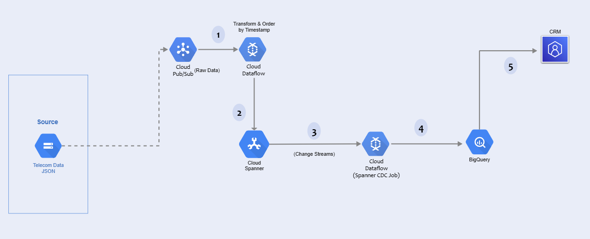
System Architecture

Slide 15

Pipeline Design Overview
01
02
JSON PARSING
DATA ENRICHMENT
The initial step where raw JSON data is converted into a usable format.
Enhancing the parsed data by adding relevant information from other sources.
03
04
TABLE -WISE TRANSFORMATION
ORDERED WRITES TO SPANNER
Transforming the enriched data into structured tables suitable for storage.
Writing the transformed data in batches to Google Cloud Spanner in a specified order.

Slide 16


IMPLEMENTED SOLUTIONS & RECOMMENDATIONS

Slide 17
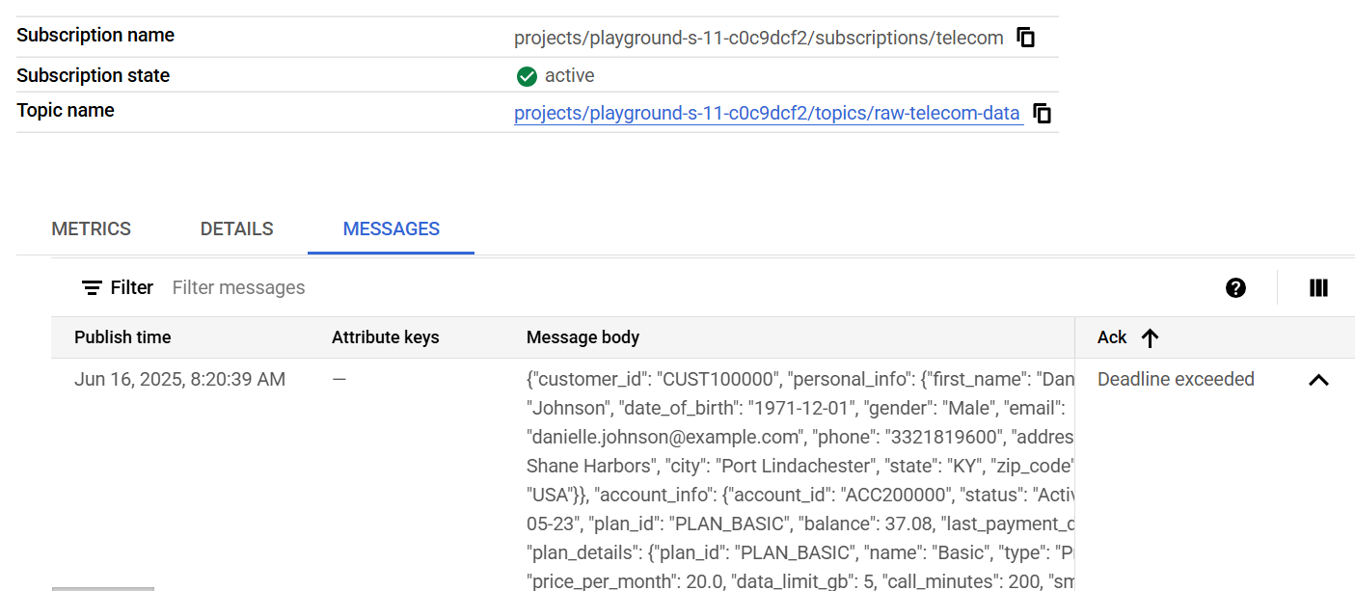
Data Ingestion via Pub/Sub
Streaming JSON data captured from telecom sources via Google Cloud Pub/Sub

Slide 18
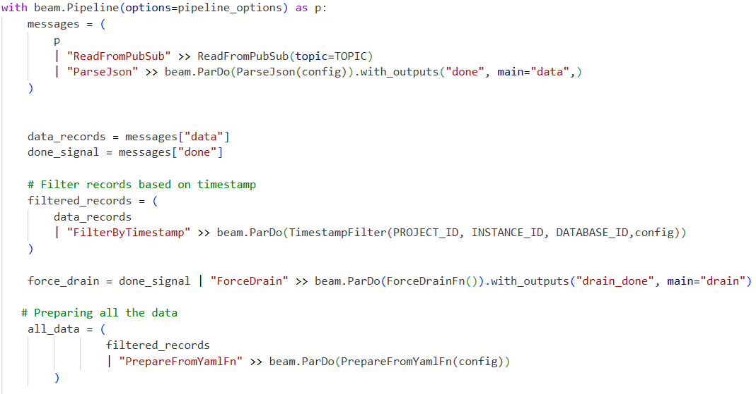
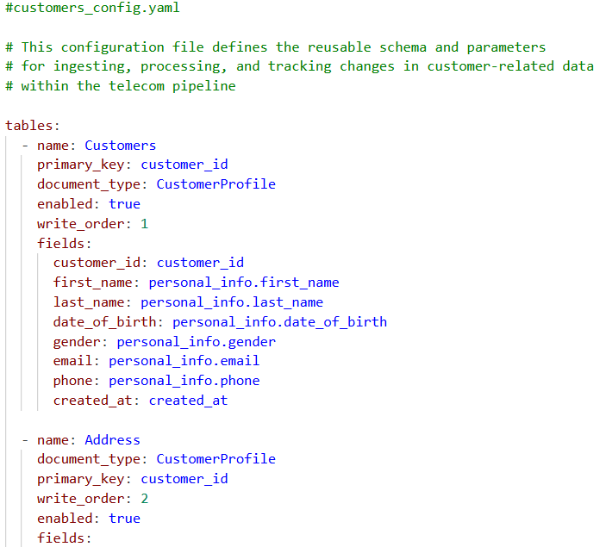
Transformation using Apache Beam
Pipeline design with reusable YAML configuration for standardized and scalable data processing

Slide 19
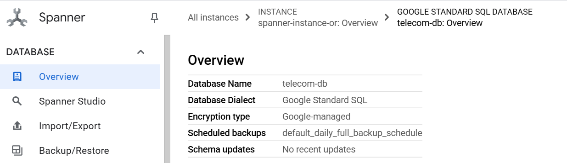
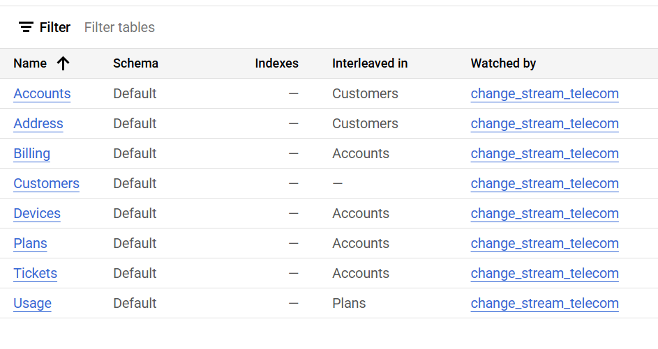
Inserting into Cloud Spanner
An overview of the Cloud Spanner console and tables

Slide 20
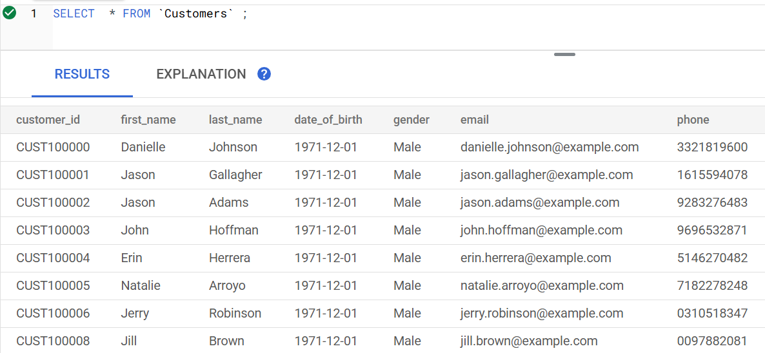
Inserting into Cloud Spanner
Structured telecom data inserted into relational tables with primary and foreign keys

Slide 21
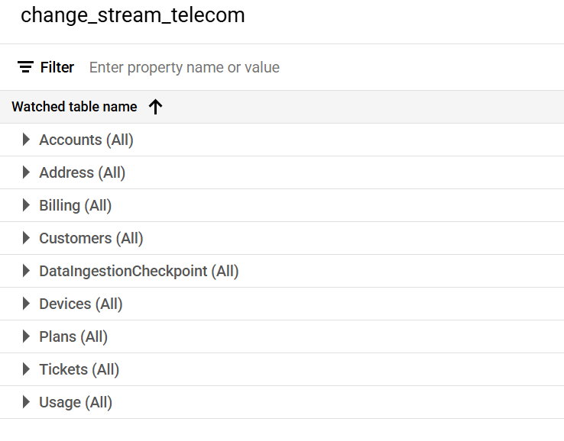
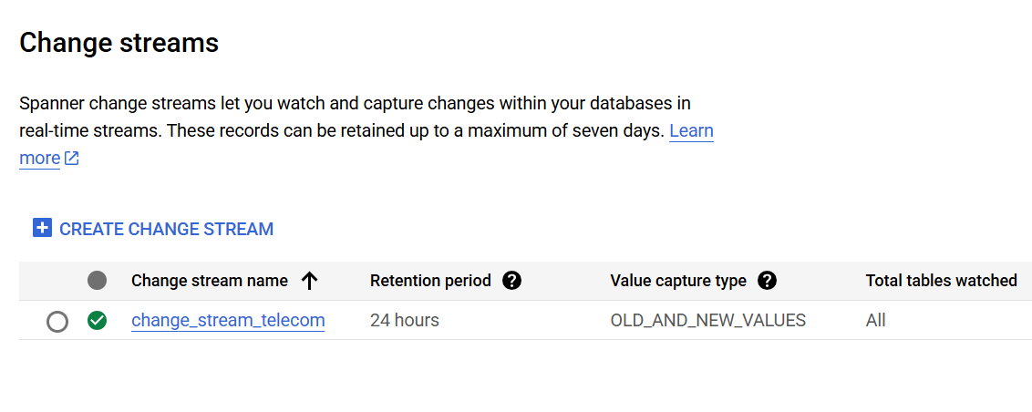
Spanner Change Streams to BigQuery
Change streams enabled for all the tables

Slide 22
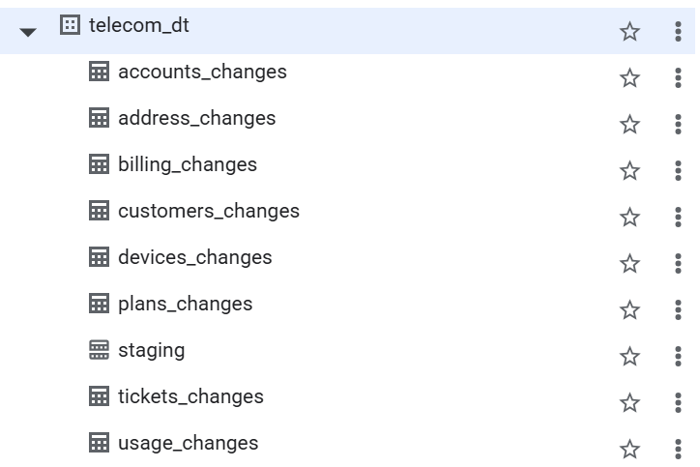
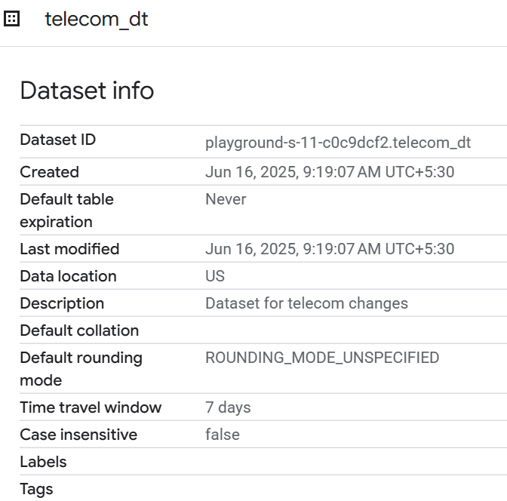
Spanner Change Streams to BigQuery
BigQuery dataset containing all the changes tables – to capture the data changes from Cloud Spanner

Slide 23
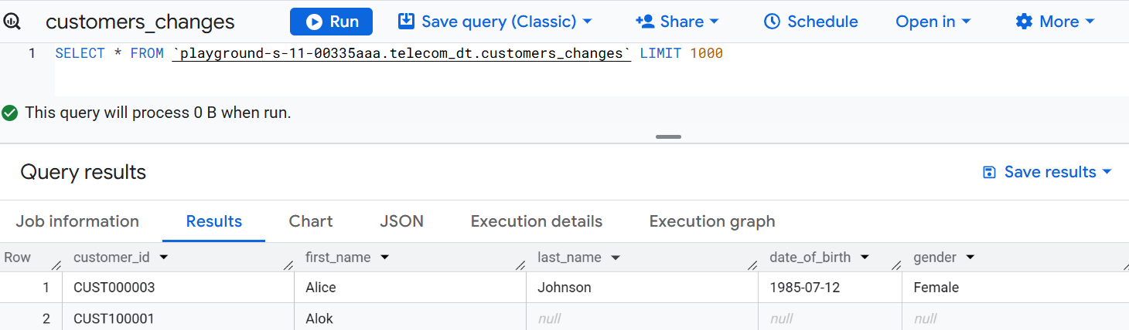
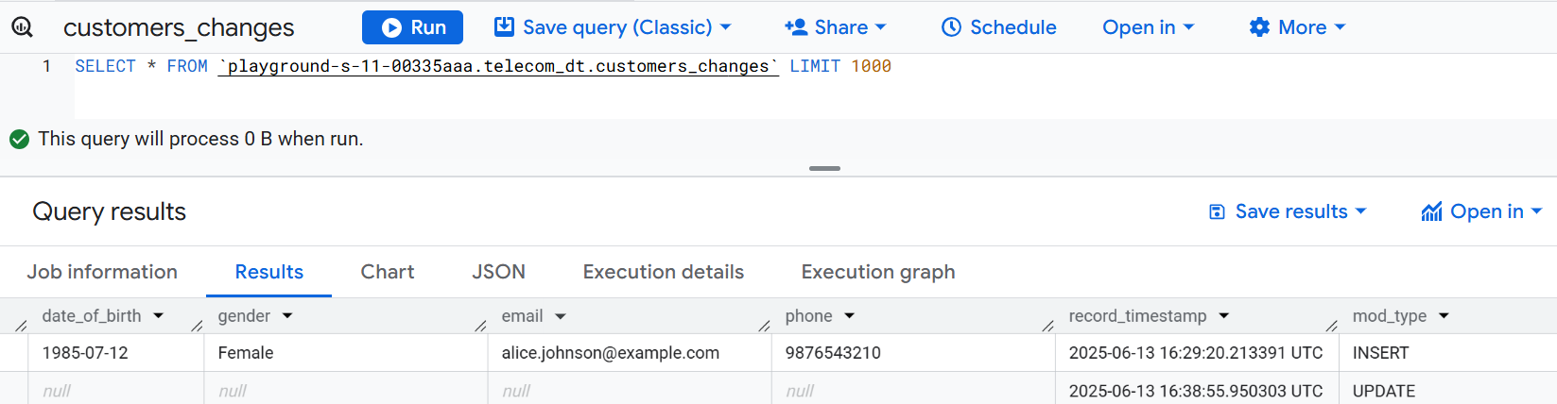
Rows in customers_changes table showing a new customer record inserted into Cloud Spanner. The mod_type and record_timestamp columns indicate change type and ingestion time.

Slide 24
Resources
Google Cloud Platform Documentation
Google Cloud Spanner Change Streams Documentation
Google Cloud Dataflow Documentation
Google Cloud Pub/Sub Documentation
Apache Beam Resources
Apache Beam Programming Guide
Beam College 2025 Sessions
Apache Beam Java SDK Documentation
Additional Learning Resources
Enterprise Data Management
Understanding Cloud Spanner
Hands on with Dataflow
Tools and Technologies Used
dbdiagram.io
EdrawMax
Git/Github

Slide 25

CHALLENGES FACED

Slide 26
Key Challenges
Technical challenges encountered during the pipeline design.
01
02
03
SCHEMA DESIGN
BEAM PIPELINE
CDC to BigQuery
Balancing normalization, interleaving, and query performance in Cloud Spanner required multiple iterations and refinements.
Defining modular transforms and managing schema enforcement in Apache Beam required careful planning and debugging.
Implementing efficient Change Data Capture logic to Spanner changes and write them into structured BigQuery tables dynamically

Slide 27




INTERNSHIP LEARNINGS

Slide 28





LEARNINGS & INTERNSHIP IMPACT
TECHNICAL LEARNINGS
REAL -WORLD APPLICATION
PERSONAL & PROFESSIONAL GROWTH
CONFIDENCE IN CLOUD ARCHITECTURE
INTERNSHIP VALUE
Gained deep hands-on experience with GCP services including Pub /Sub, Dataflow, Spanner, and BigQuery, along with Apache Beam coding patterns for performance optimization.
Implemented a real-world CDC and ETL pipeline with real-time constraints, enhancing practical skills in data handling.
Developed an under standing of how modern cloud systems operate within large scale telecom - companies while improving colla boration and project management skills.
Gained confidence in cloud architecture and backend design through hands-on experience and project work.
This project significantly enhanced my understanding of cloud-native data engineering, building a strong foundation for big data systems in production.

Slide 29
Thank You

